Slide 1
Linux Security Compliance Scanner
By Bhavya

Slide 2
Abstract:
Linux Security Compliance Scanner is a Bash-based security tool that audits the linux Operating system and identifies common security misconfigurations.
Modern computer systems face various configuration issues that put the system at risk of being compromised.
The issues include open ports, insecure file permissions, weak password management, disabled firewalls, and outdated packages.
The main goal of the project is to automate the identification of common security weaknesses using Linux system commands.

Slide 3
Problem Statement
Many Linux systems are deployed with default configurations that may not follow security best practices.
Administrators often overlook important security settings such as firewall rules, password policies, SSH configurations, and file permissions.
Attackers commonly exploit misconfigured systems to gain unauthorized access, escalate privileges, or execute malicious activities.
Manual security auditing is time-consuming and requires deep knowledge of system configuration files and security standards.

Slide 4
The Solution: Why we Need an Automated Fix
• Security misconfigurations are one of the most common causes of system
vulnerabilities.
Manual inspection of security settings can be inconsistent and prone to human error.
Automated tools make sure that every system is evaluated using the same security checks.
The Linux Security Compliance Scanner automates the process of checking system security configurations. The tool performs multiple checks in a structured and repeatable way.

Slide 5
Tools and Technologies Used
To build this automatic security patch script, we're using a collection of powerful tools that are all part of the Linux environment. Here's a simple breakdown of our toolkit and why each piece is so important:
Important Linux tools used: • ss – to find open network ports • grep lets you search through configuration files. • systemctl is used to manage and check system services. • ufw – for checking firewall status • apt – for checking system updates
In a nutshell:
Kali Linux: Our operating system.
APT: The tool that handles all the updates.
Bash: The language we write the script in.
Nano/Vim: What we use to write the code

Slide 6
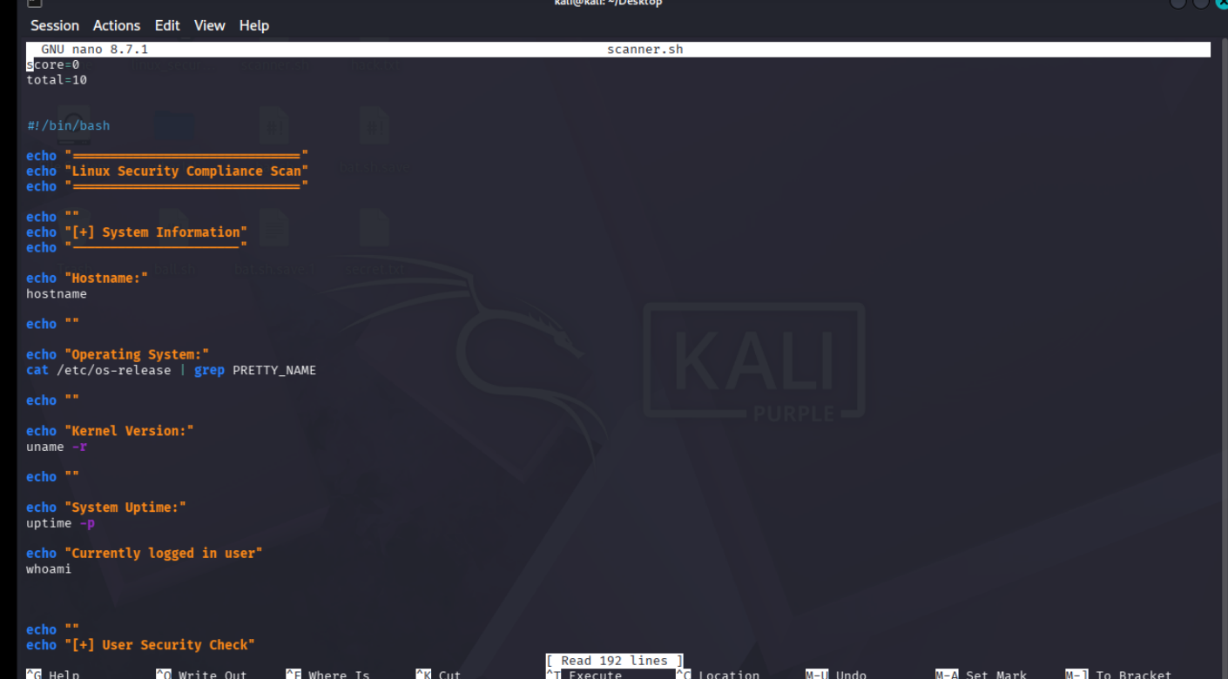
Project Implementation

Slide 7
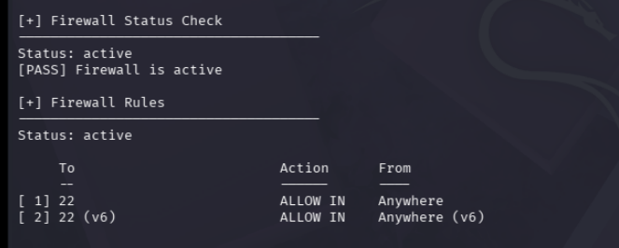
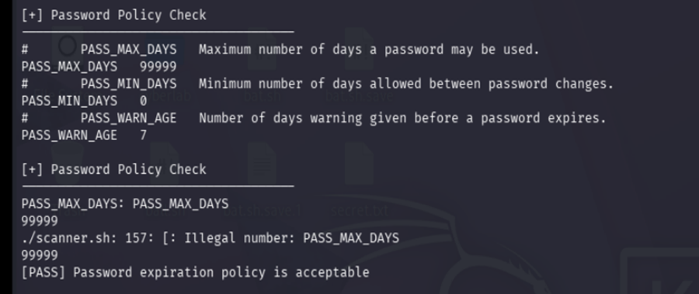


Slide 8
Conclusion
The Linux Security Compliance Scanner shows how to use Bash scripting and Linux tools to automate system security auditing.
The project shows how important it is to find configuration-based vulnerabilities in Linux systems.
Automated scanning makes security auditing easier and raises awareness of system security.
The scanner helps administrators find problems like weak password policies, SSH configurations that aren't secure, and updates that are missing.

Slide 9


